Slide 1
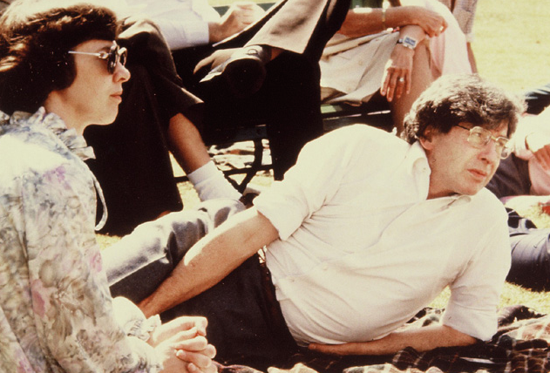
Jean Purdy and Bob Edwards

Slide 2
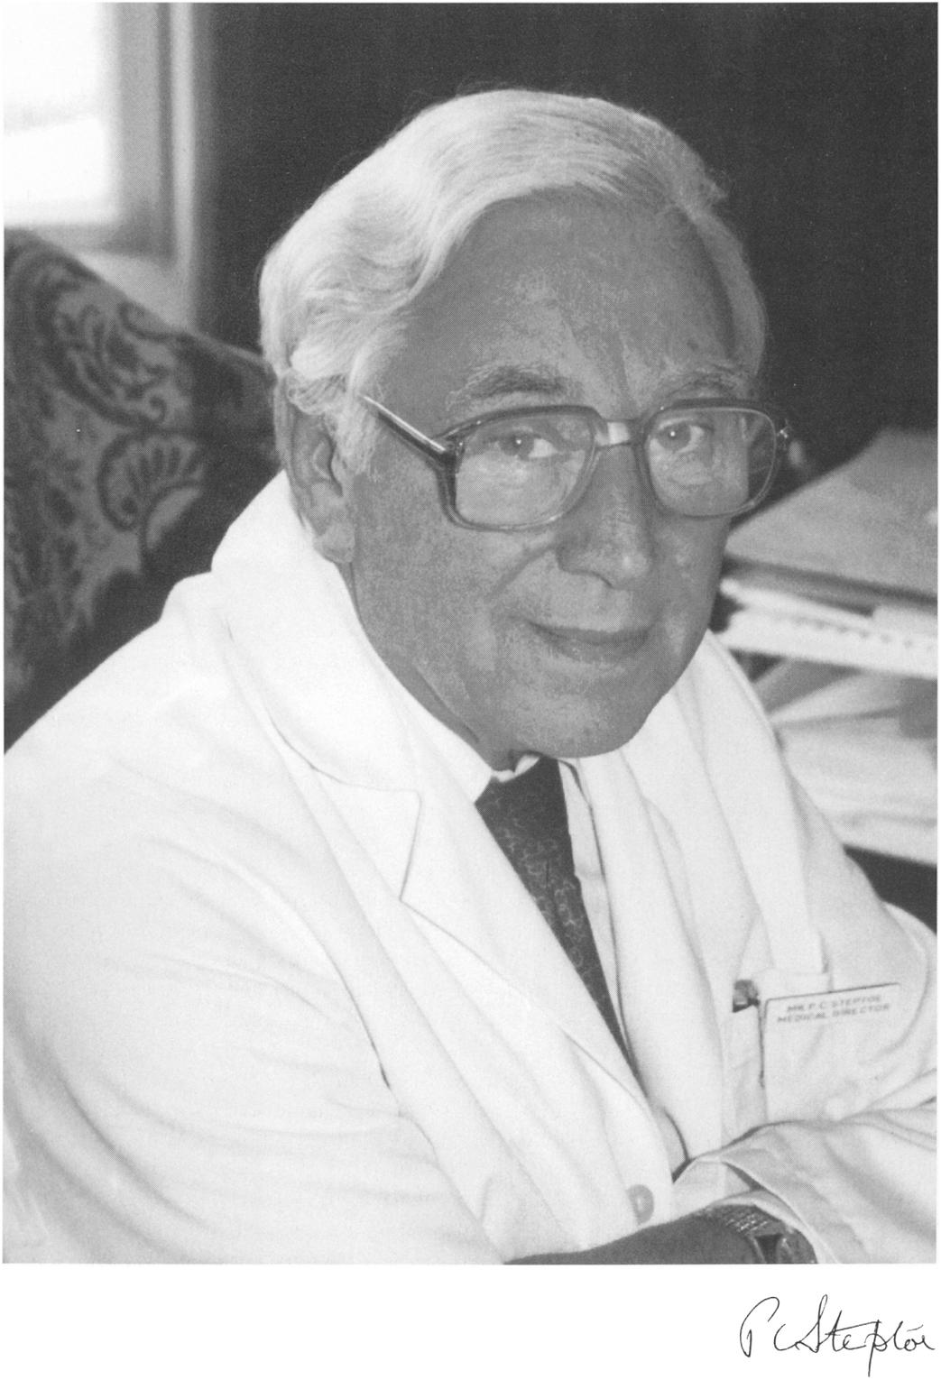
Patrick
Steptoe

Slide 3
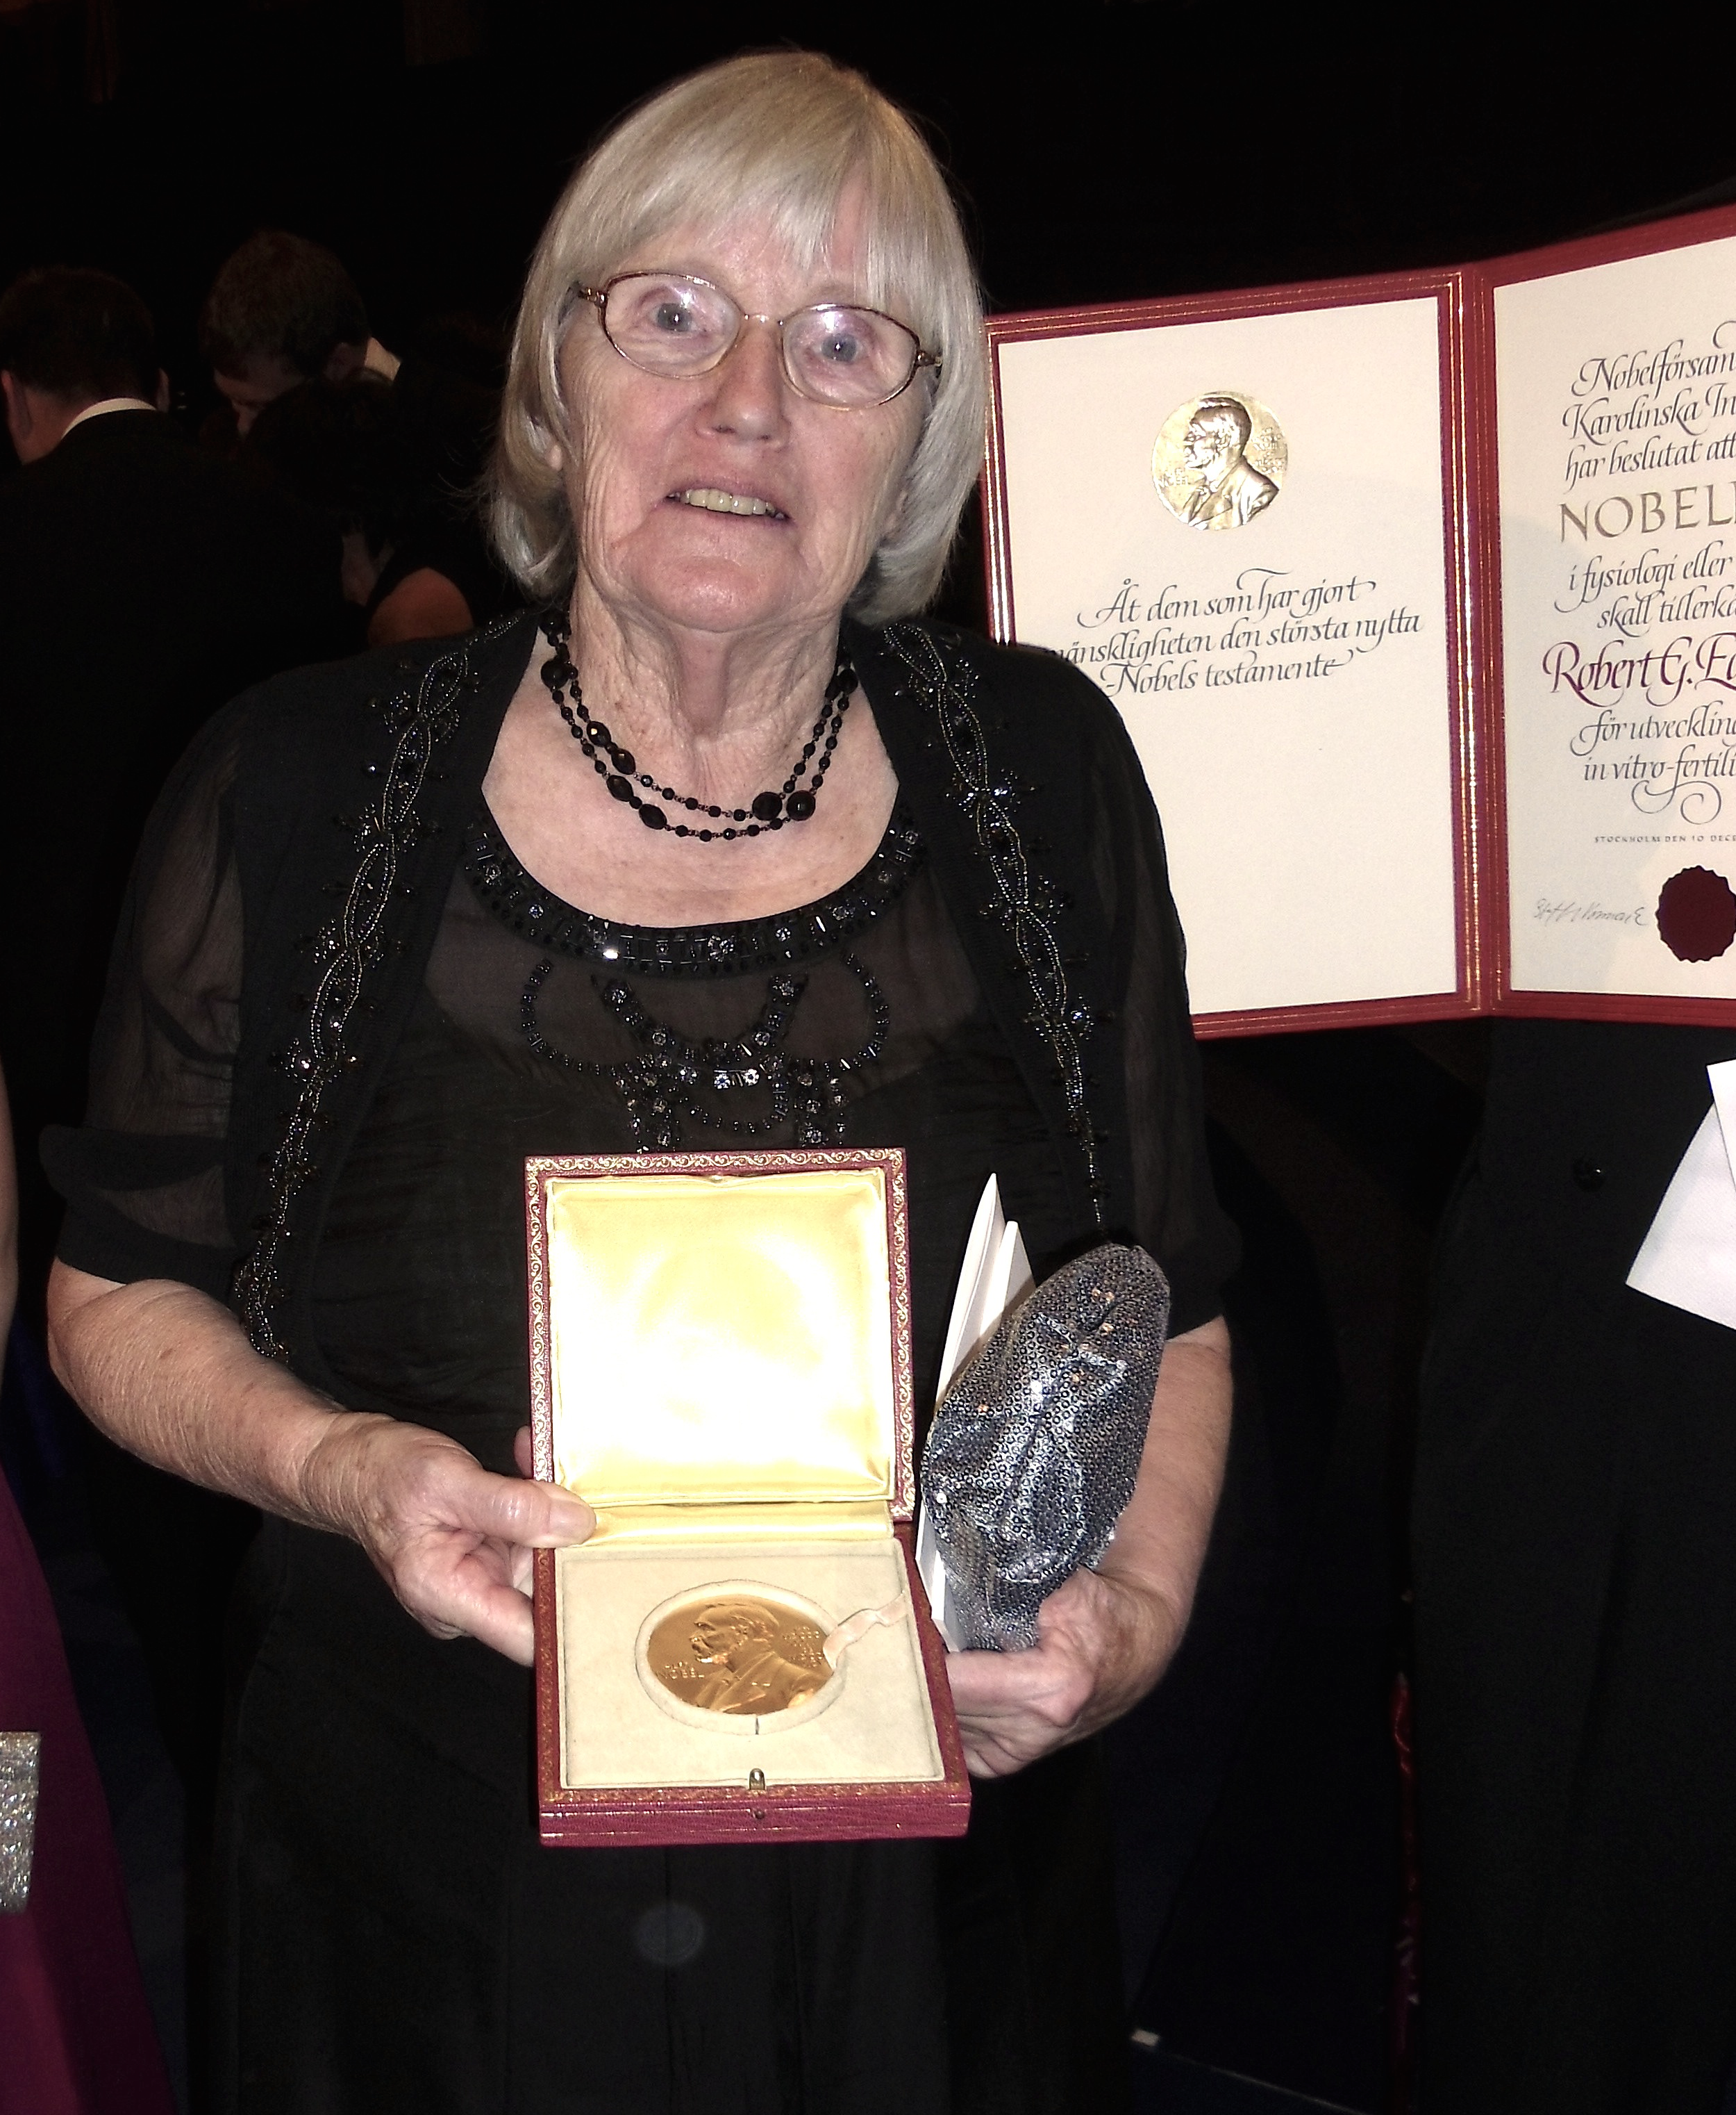
Ruth Fowler-Edwards
with the Nobel medal she
collected on behalf of Bob

Slide 4
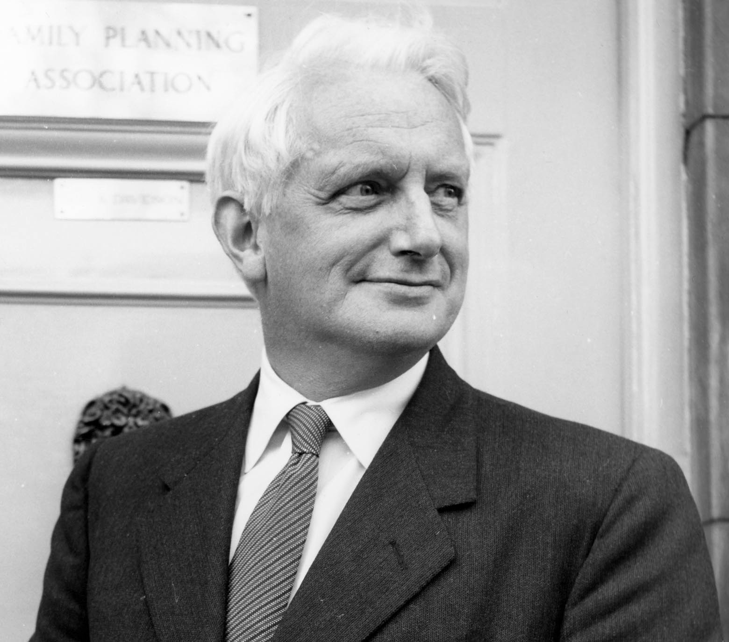
Sir Alan
Parkes

Slide 5
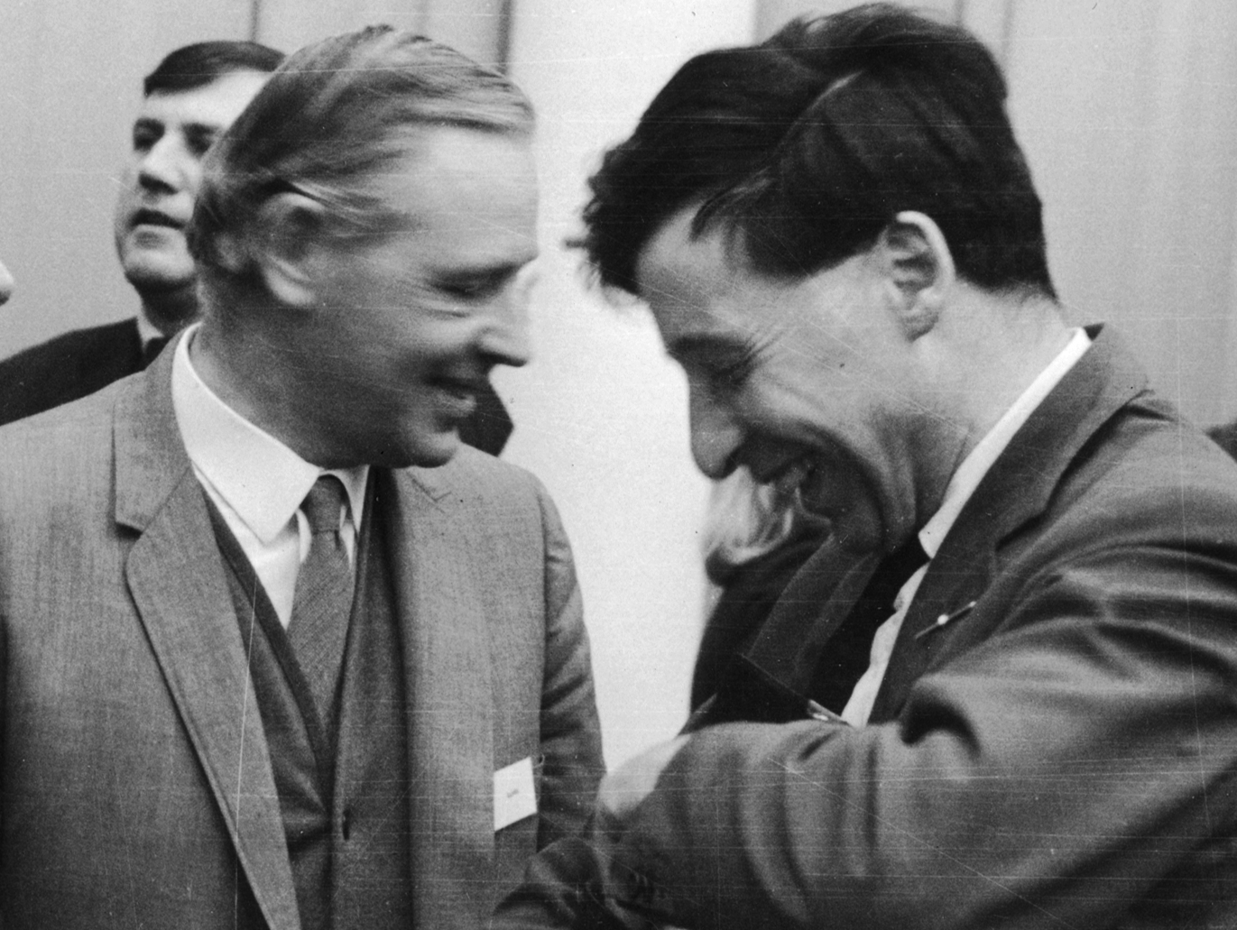
Bunny Austin and Bob Edwards

Slide 6
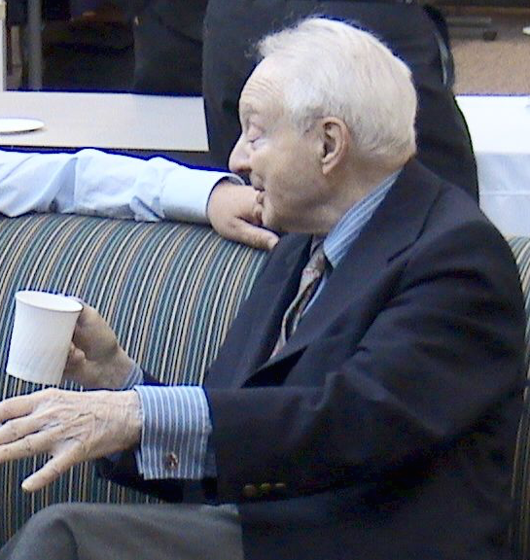
“Bobski”
Szulman

Slide 7
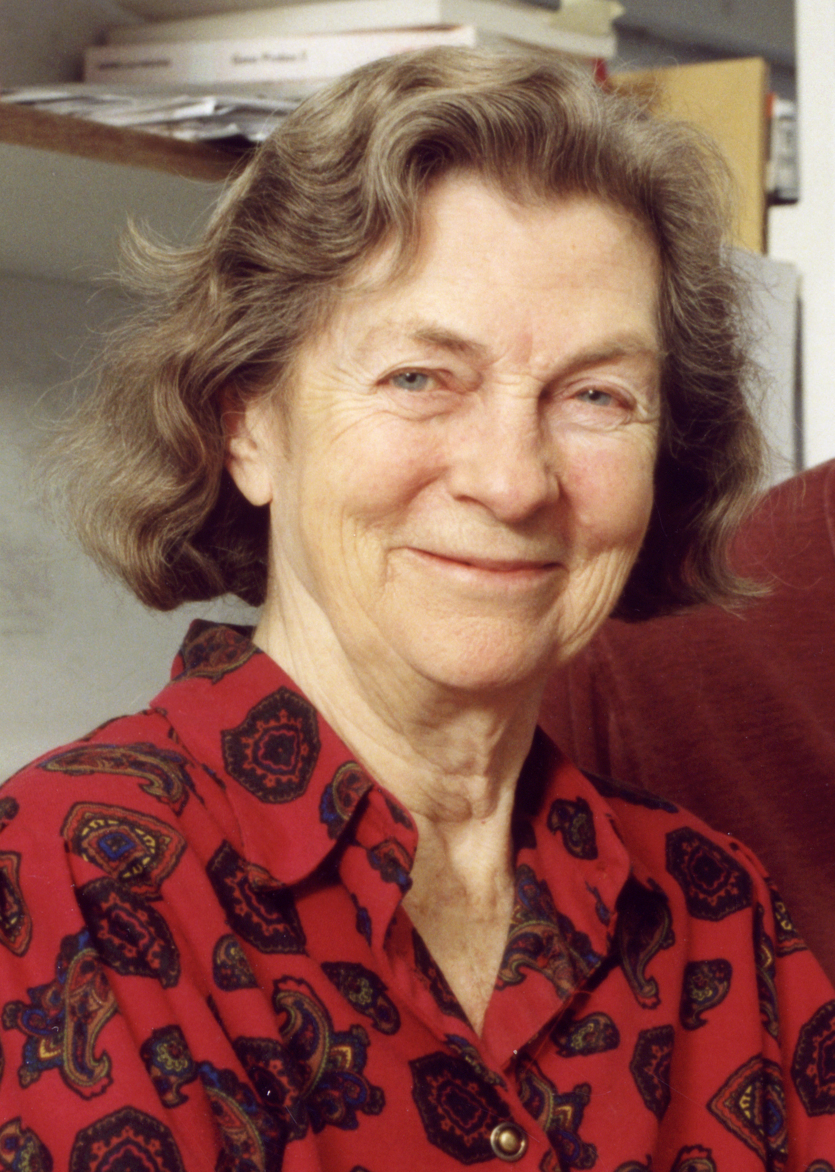
Dame Anne
McLaren

Slide 8
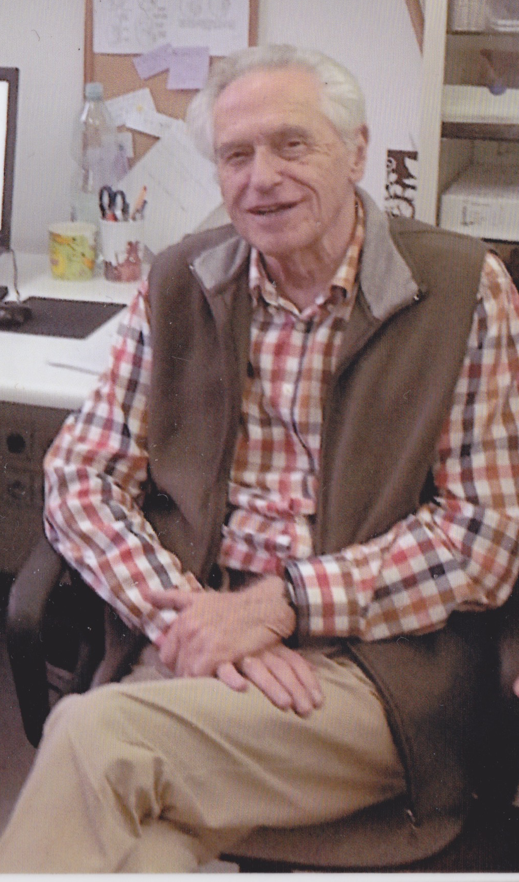
Andrzej Tarkowski

Slide 9
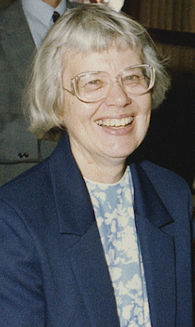
Mary Lyon

Slide 10
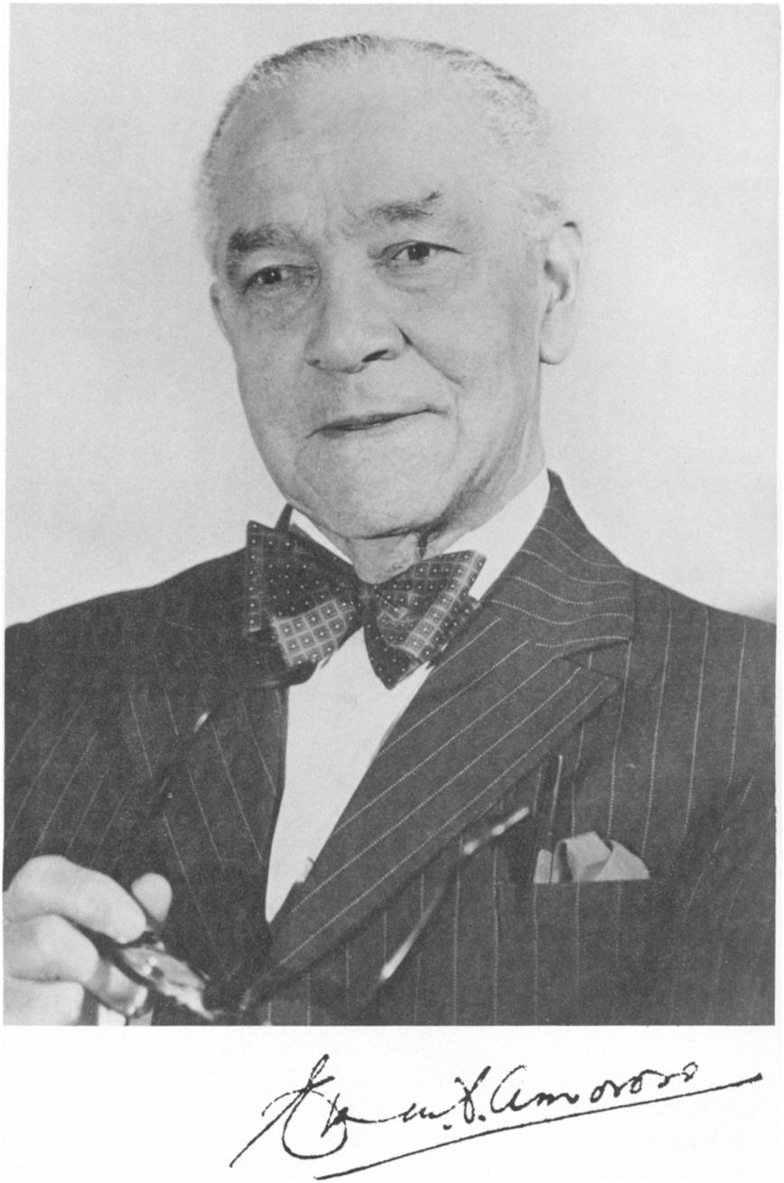
“Amo”
Amoroso

Slide 11
Lynne Selwood

Slide 12
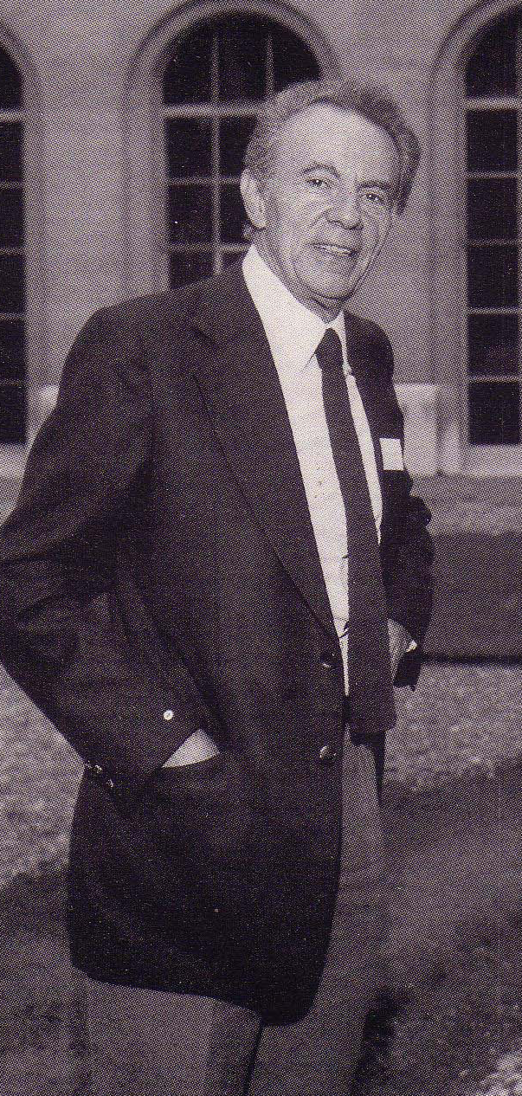
Francois Jacob

Slide 13
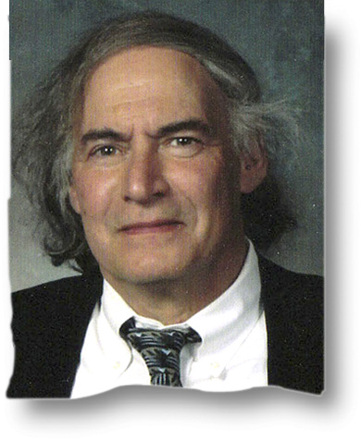
Jonathan
Van Blerkom

Slide 14
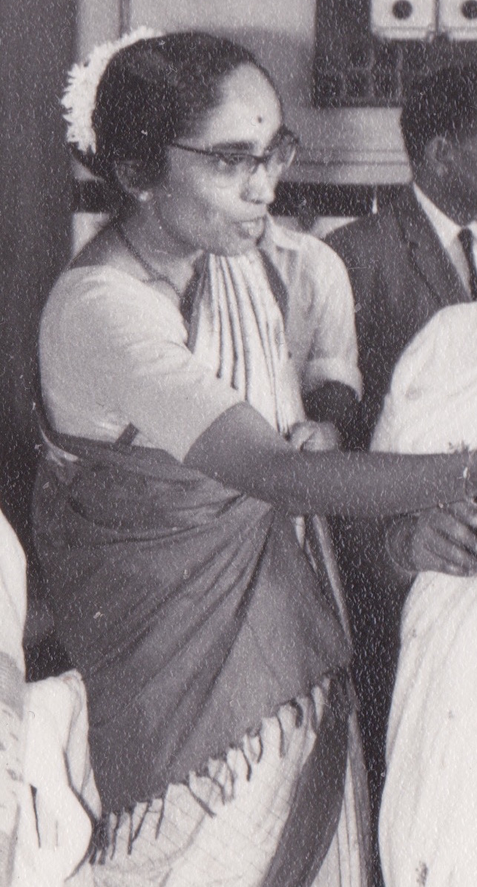
Shanta Rao

Slide 15
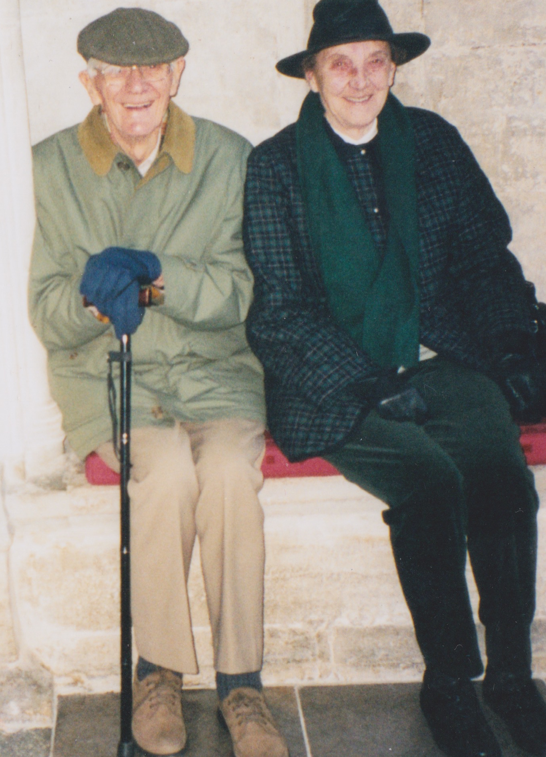
Mum and Dad

Slide 16
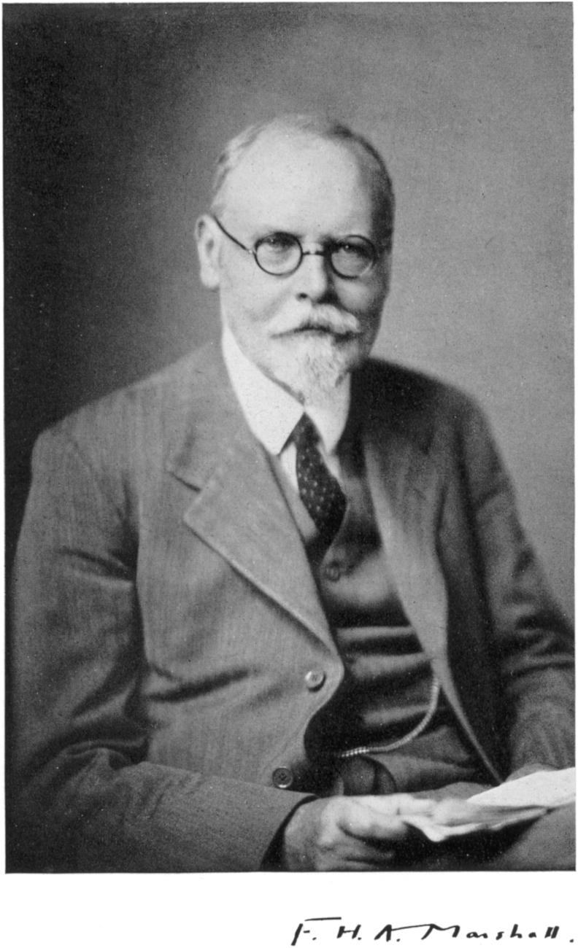
Tibby Marshall

Slide 17
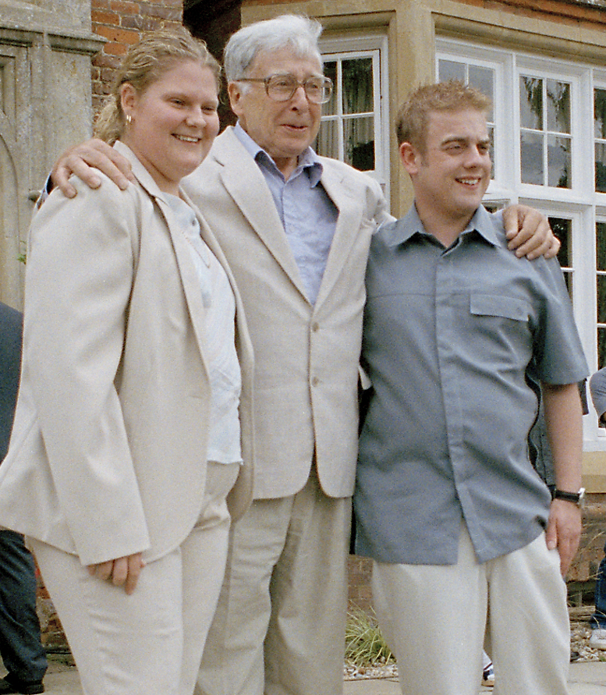
Bob Edwards with
Louise and Alistair

